Slide 1
Robot periodic report
End of stage 2

Slide 2
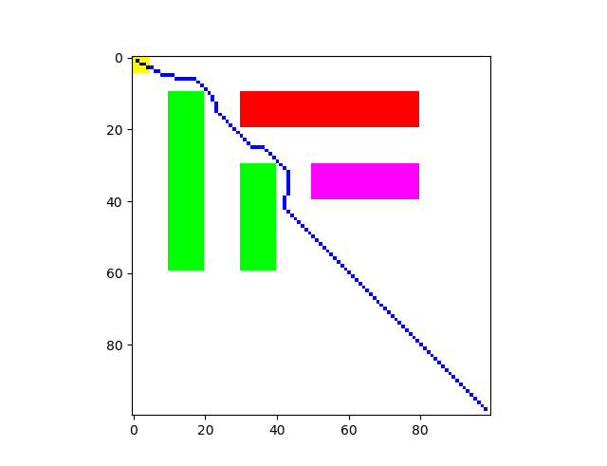
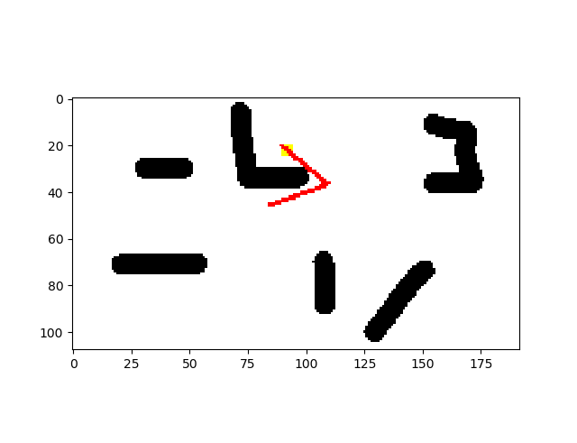
Two projects
Exploitation of the influence coefficient
2D robot arm control

Slide 3
advantages
Working for both project
Rather fast (project 1)
Instance for project 1 (10e4)
1.5 min for project 2 (10e6)

Slide 4
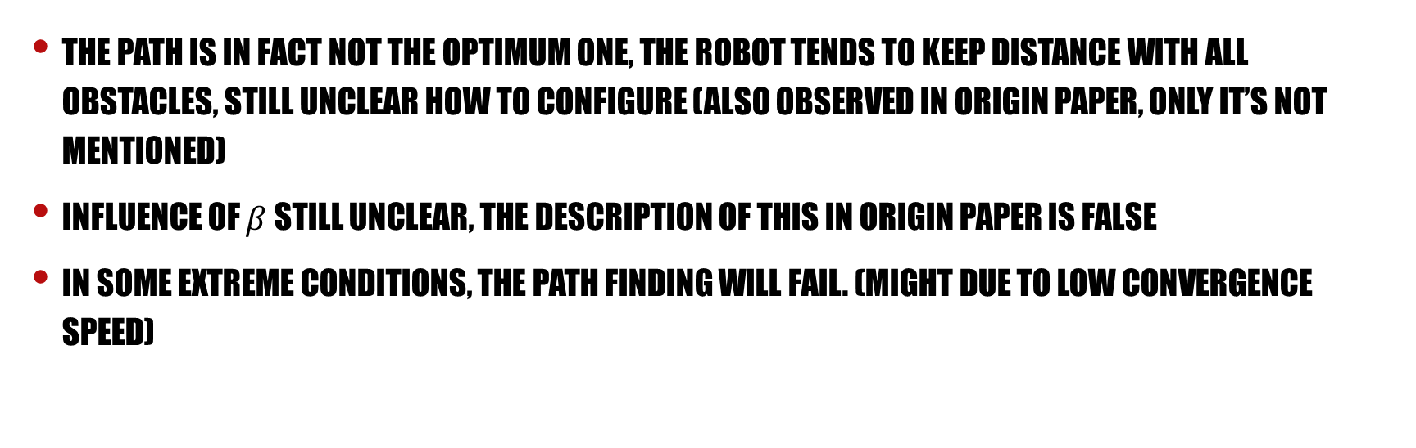
disadvantages
The path is in fact not the optimum one, the robot tends to keep distance with all obstacles, still unclear how to configure (also observed in origin paper, only it’s not mentioned)
Influence of $β$ still unclear, the description of this in origin paper is false
In some extreme conditions, the path finding will fail. (might due to low convergence speed)

Slide 5
Questions
Materials required by the course
Further investigations
Reasons that limit the convergence speed
Optimize the finding process for better results

Slide 6
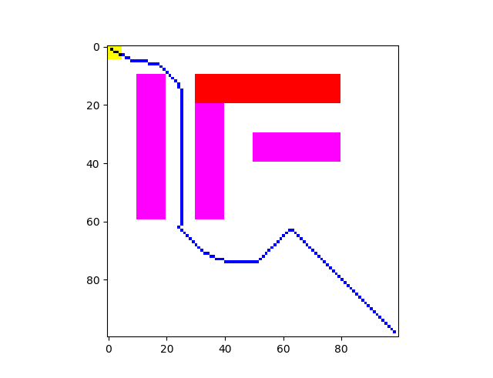
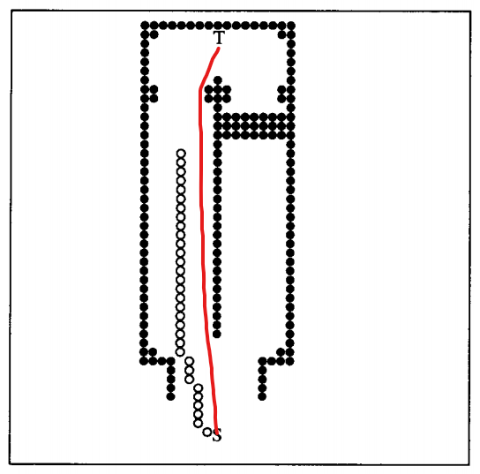
Keeping distance

Slide 7
Optimizations concerning beta
Limit the value to accelerate the spreading speed near obstacles (beta differs for neurons)
Try other functions for g

